Slide 1
AI & ML AUDIO SEPARATION
OD91IIITK
~Hassan Muhammed Ahsan A.Ankith Reddy
118cs0036 118cs0034

Slide 2
Tensorflow Model
We have built an ANN Model by training with Urban Audio Dataset.
Dataset: https://paperswithcode.com/task/music-source-separation
We are using an open source, existing premodel which seperates the music into Vocal, Bass, Jazz, but we need specific catagories of music instruments for seperation
We are using the model as a reference so that we can develop our own model
We are using MUSDB18 Dataset as its is pre trained and we are trying to integrate it into our own code.

Slide 3
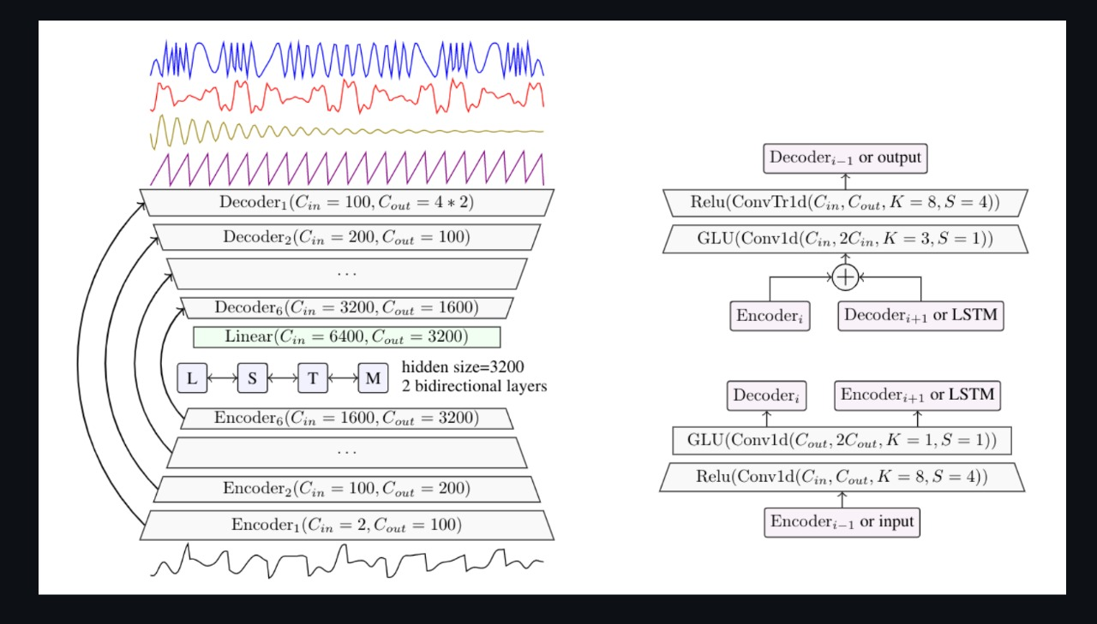
https://github.com/facebookresearch/demucs
Model:

Slide 4
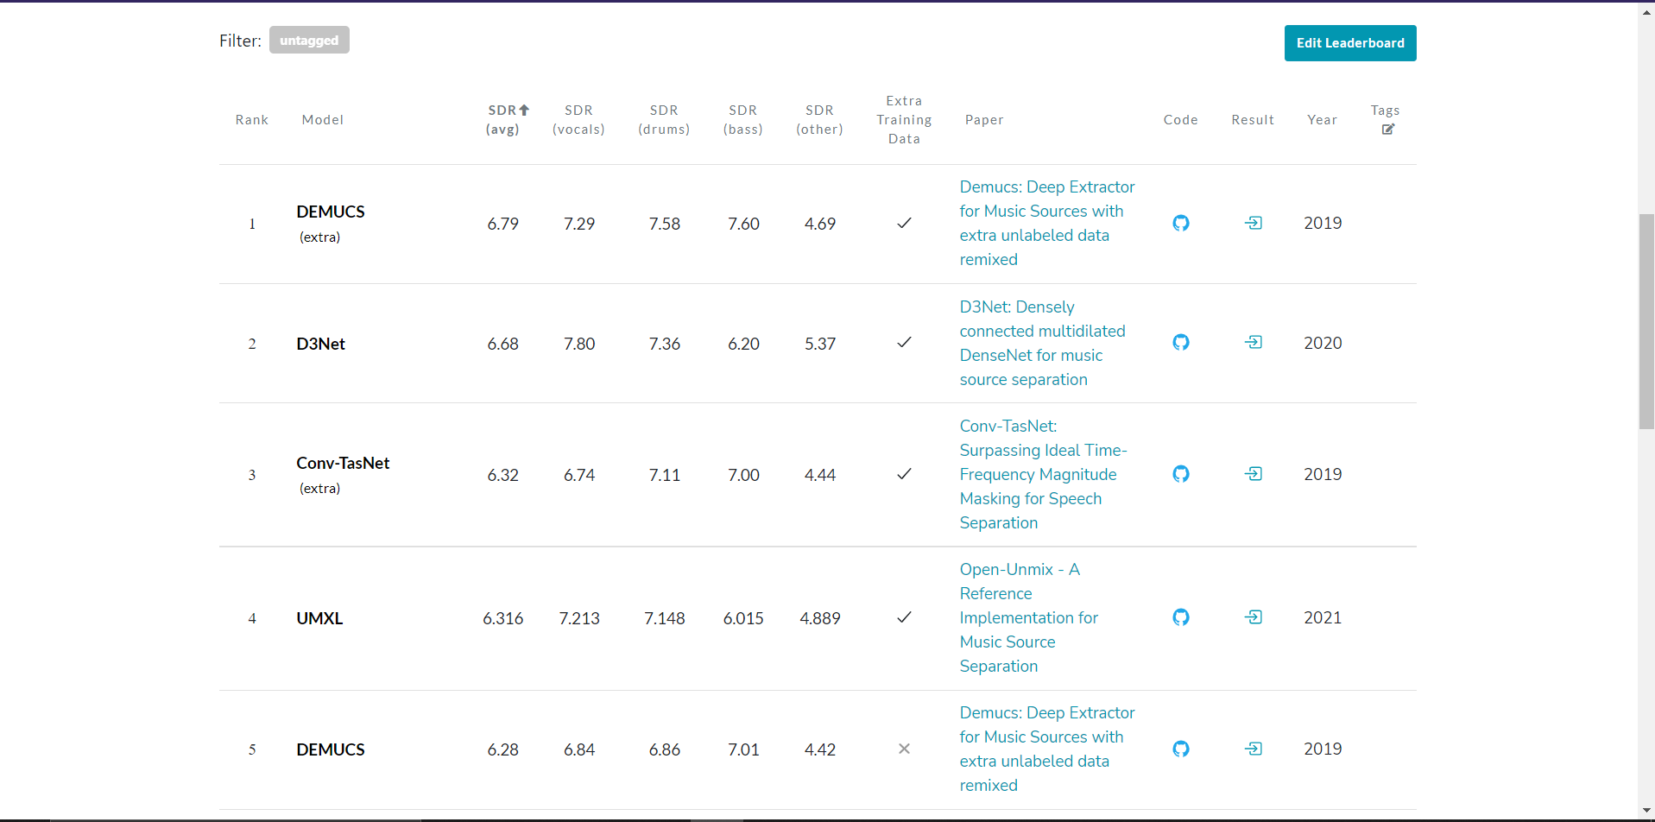
Top pre trained model

Slide 5
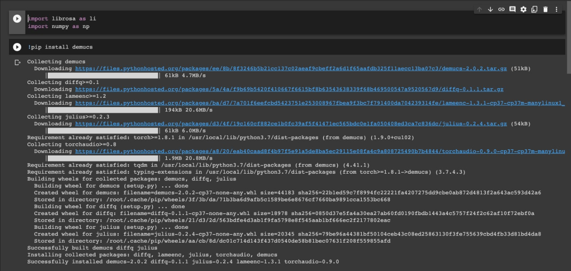
Output

Slide 6
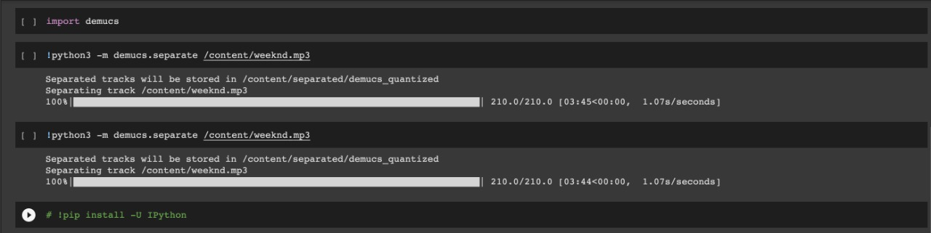

Slide 7
Problems
We are unaware of the specific categories we need to classify the sound into
We need the dataset required for building the model
What types of Classification needs to be done.

Slide 8
MAKING OF MUSIC PLAYER
For making the app, I have learned Java and working of the Android Studio.
Started working on the from 5th June.
Made progress in from 3rd week of June
Tried integration of our model into app but failed many time

Slide 9
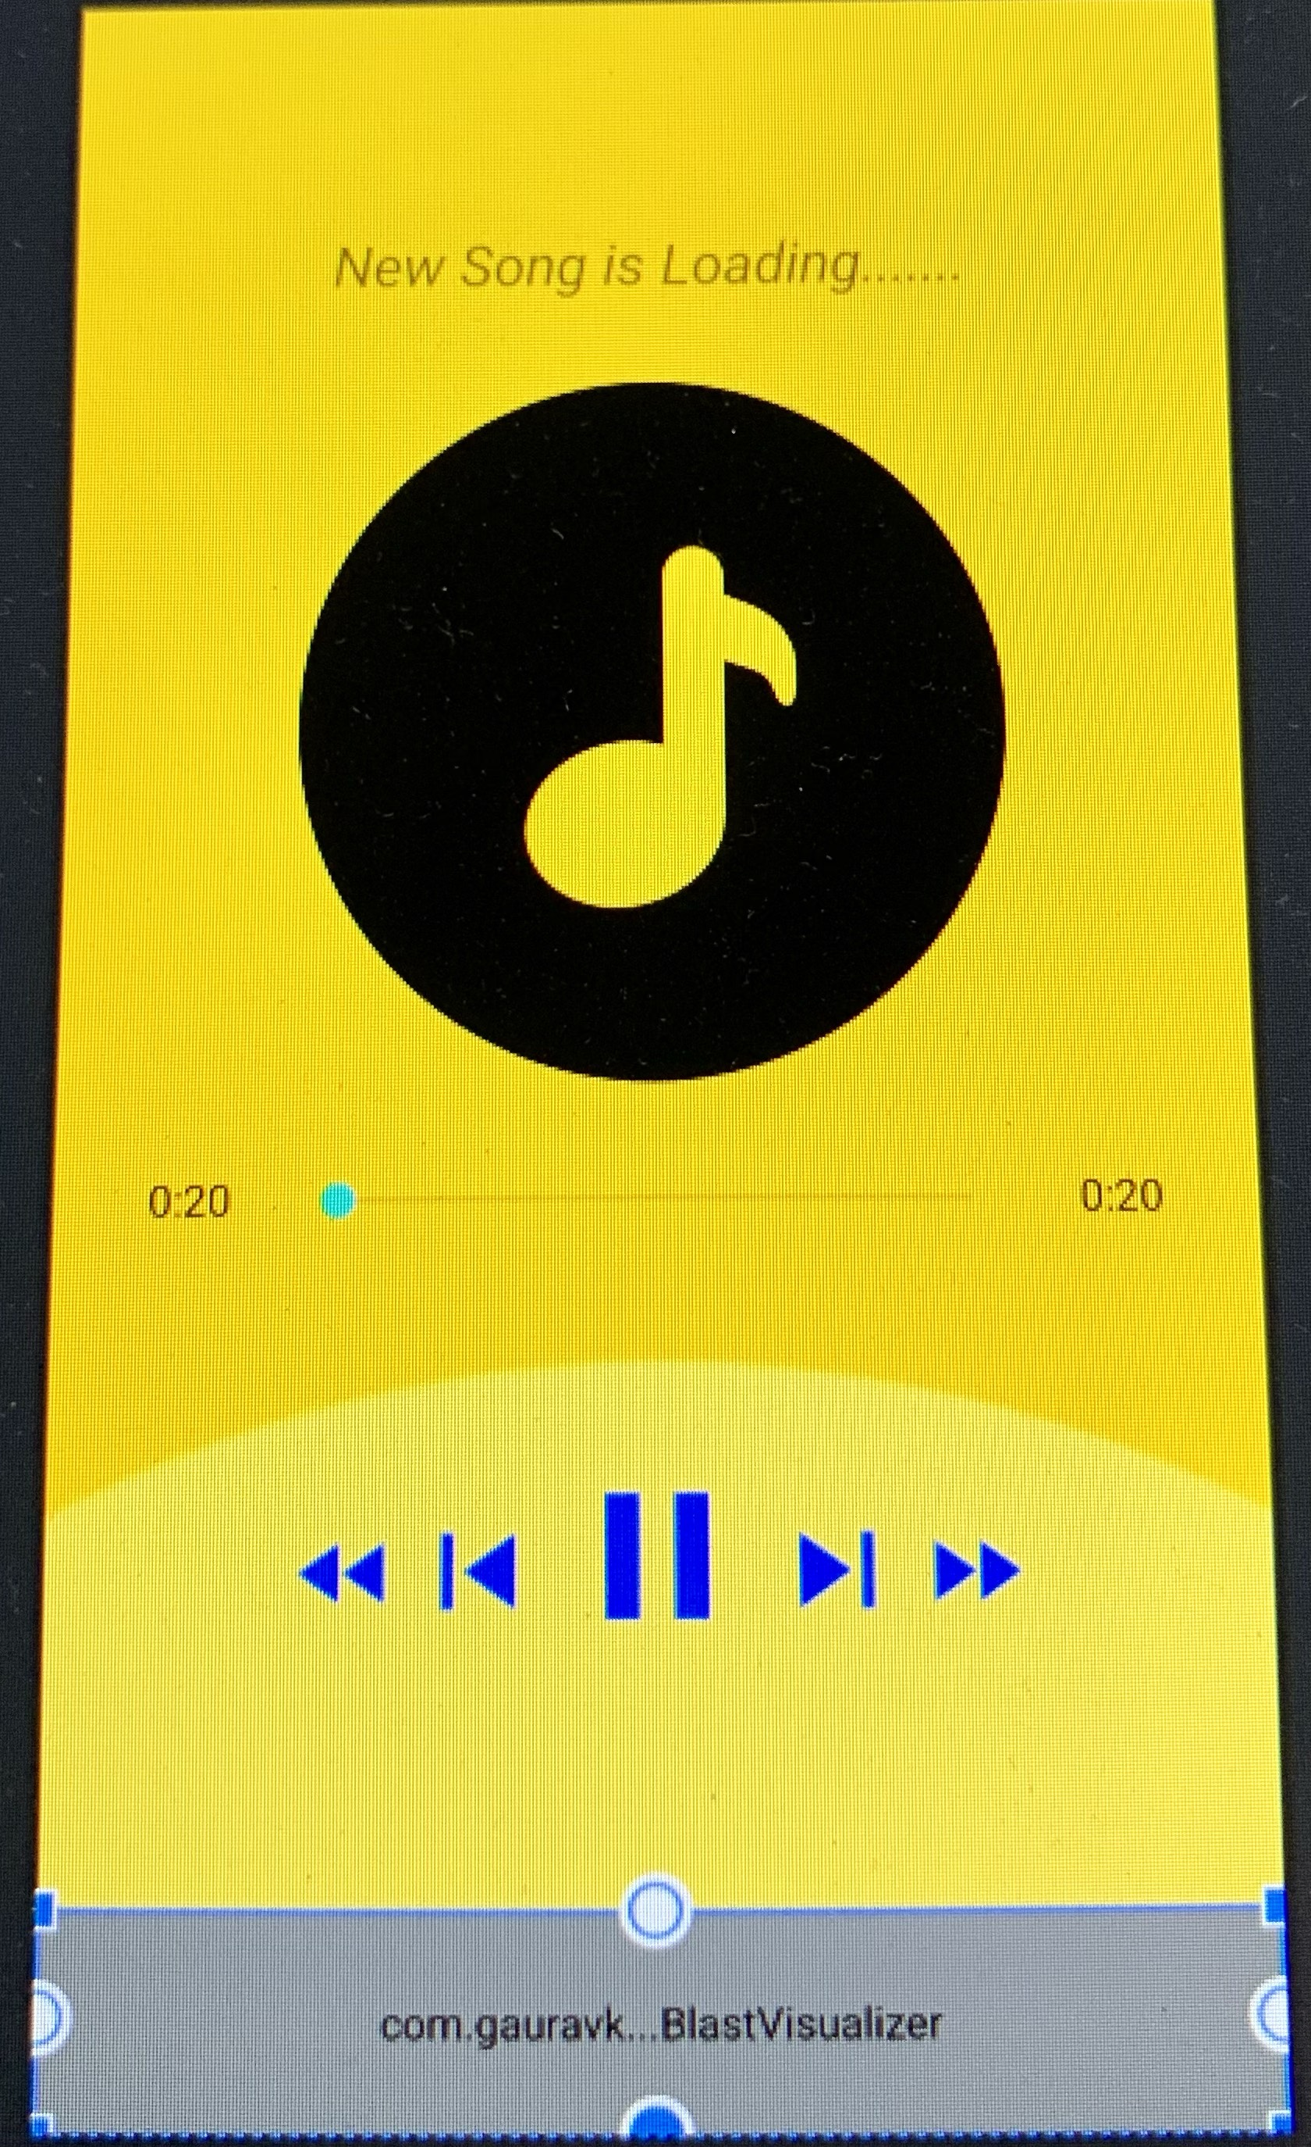
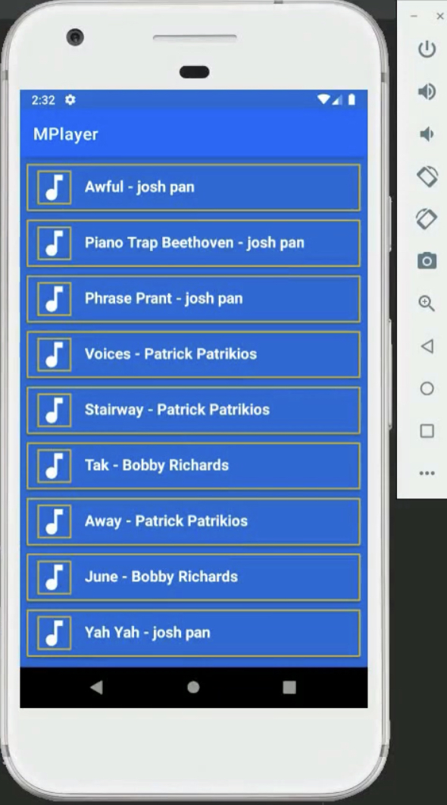

Outline of the App
This is what it will look when you a song
In the place of new song is loading will be replaced by name of the current playing song.
In the process of making this app we will be asking permission from the user

Slide 10
Problems
We have fixed as many bugs as possible, but their are still bugs that we are facing in the app
Intergation of Tensorflow with App.

Slide 11
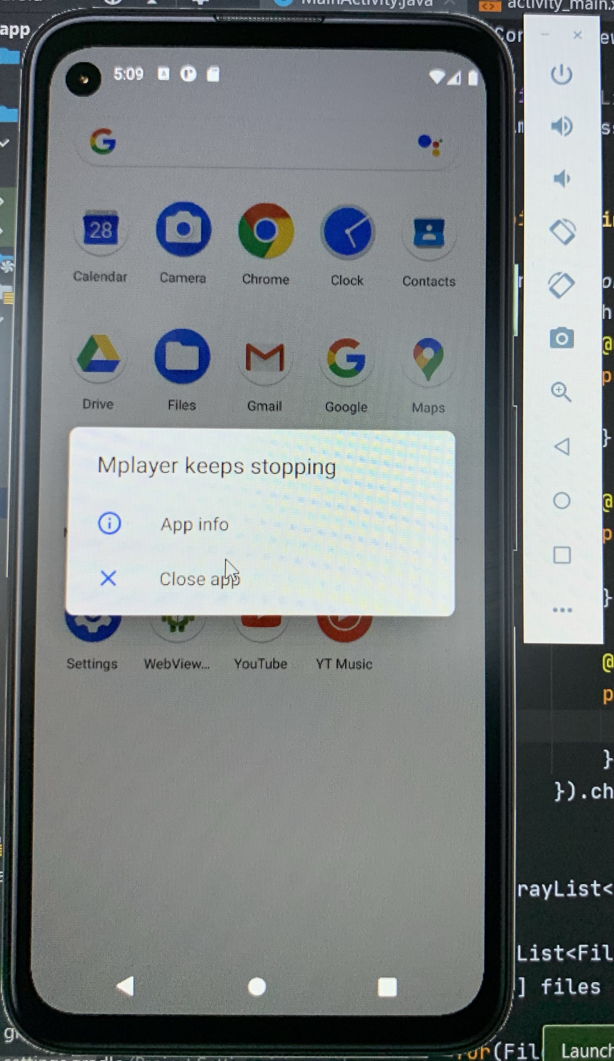
The app is based on Java, due to some changes made in the it keeps getting crashed

